Slide 1

Web Programming AndDesign
Week 4
Web Graphics & Visual Elements

Slide 2
Learning Outcomes
Create and format lines and borders on web pages
Apply the image element to add graphics to web pages
Configure images as backgrounds on web pages
Configure images as hyperlinks
Configure visual effects including multiple background images, rounded corners, box shadow, text shadow, opacity, and gradients

Slide 3

Learning Outcomes (cont’d)
Configure RGBA with CSS3
Add caption to a figure
Use the HTML5 meter and progress elements
Follow recommended web design guidelines for graphics on web pages

Slide 4
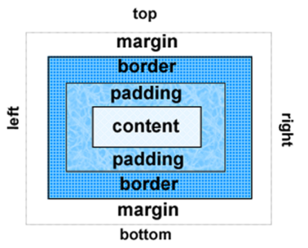
CSS Box Model
Content
Text & child elements in the container
Padding
Area between the content and the border
Border
Between the padding and the margin
Margin
Empty space between adjacent elements

Slide 5
Box model - margin
Empty space between the adjacent elements
Related properties:
margin-top, margin-right, margin-left, margin-bottom
margin(shorthand)
Examples
h1 { margin: 0; }
h1 { margin: 20px 10px; }
h1 { margin: 10px 30px 20px; }
h1 { margin: 20px 30px 0 30px; }

Slide 6
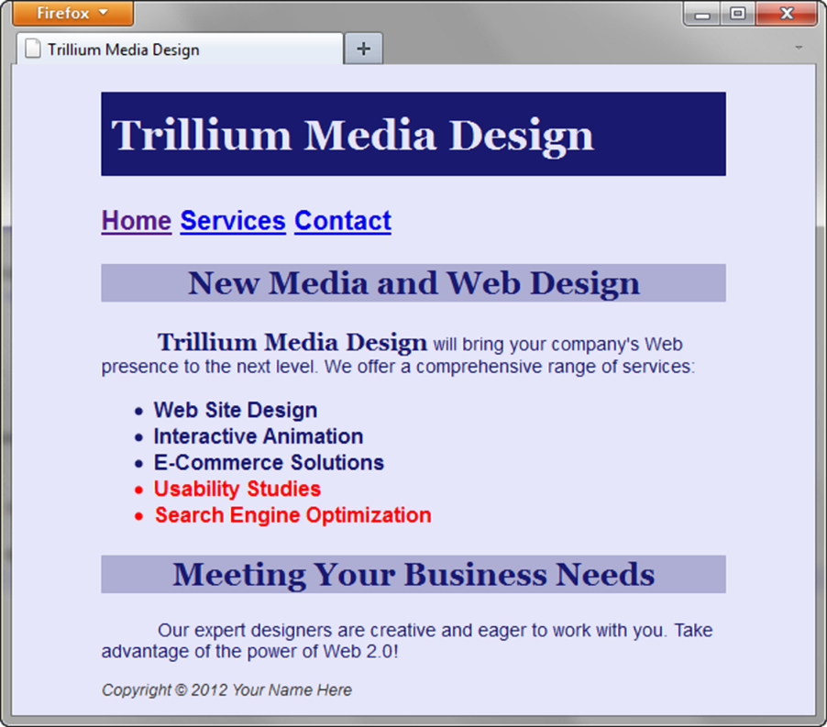
margin property
#wrapper{ margin-left: auto;
margin-right: auto;
width:80%; }
Empty space surrounding an element
Example: Centering page content

Slide 7
Box model - border
Straight lines surrounding the padding of an element
Related properties:
border-width, border-color, border-style
border-top, border-right, border-border-bottom, border-left;
border(shorthand)
examples
h1 { border: none; }
h1 { border-left : 1px solid red; }
h1 { border : 2px dotted #efcdab; }

Slide 8

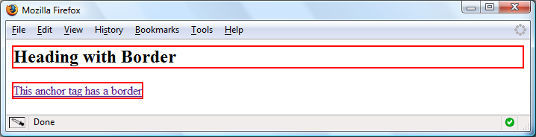
border examples
h2 { border: 2px solid #ff0000; }
a { border: 2px solid #ff0000; }
…
<h2> Heading with Border</h2>
<a>This anchor tag has a border</a>

Slide 9

border on specific sides
Use CSS to configure a line on one or more sides of an element
border-bottom
border-left
border-right
border-top
h2 { border-bottom: 2px solid #ff0000 }

Slide 10
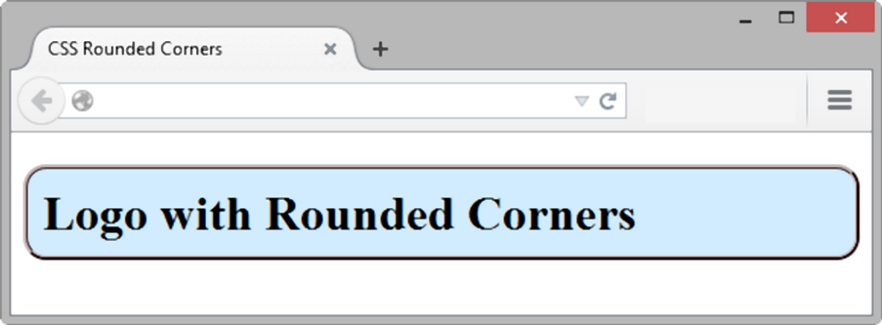
Rounded Corners
Configures the horizontal radius and vertical radius of the corner
Numeric value(s) with unit (pixel or em) or percentage
h1 { border-radius: 15px;}

Slide 11
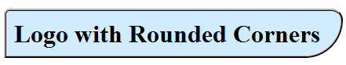
Rounded Corner Example
Four values: top-left, top right, bottom right, bottom left
border-radius: 15px 30px 100px 5px;

Slide 12
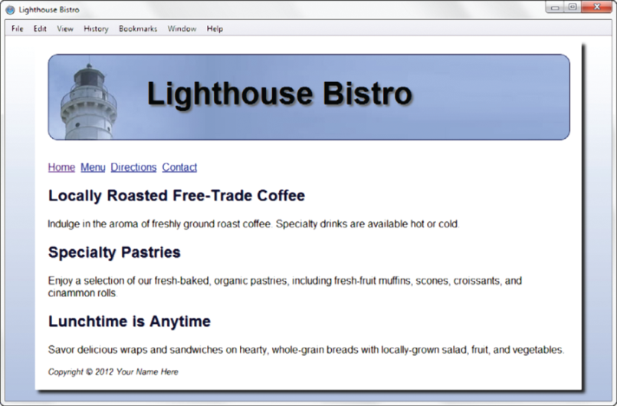
box-shadow Property
Configures horizontal offset, vertical offset, blur radius, and shadow color
#wrapper { box-shadow: 5px 5px 5px #828282; }

Slide 13
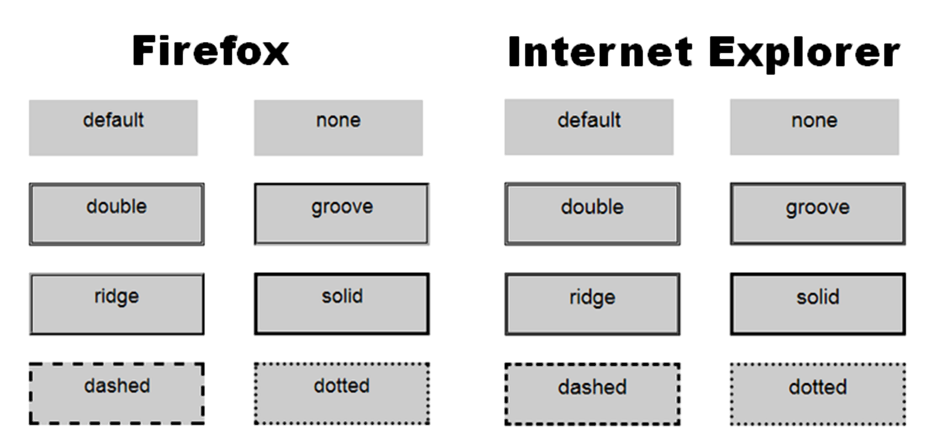
Browser Display Can Vary

Slide 14
Box model - padding
empty space between the content of the HTML element (such as text) and the border
Related properties:
padding-top, padding-right, padding-left, padding-bottom
examples
h1 { padding: 0; }
h1 { padding : 20px 10px; }
h1 { padding : 10px 30px 20px; }
h1 { padding : 20px 30px 0 30px; }

Slide 15
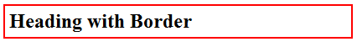

padding Property
space between the content & border of an element
h2 {padding: 5px; }

Slide 16

Padding on specific sides
Use CSS to configure padding on specific sides of an element
padding-bottom
padding-left
padding-right
padding-top
h2 { padding-left: 5px;
padding-bottom: 10px;
padding-top: 10px;
}

Slide 17
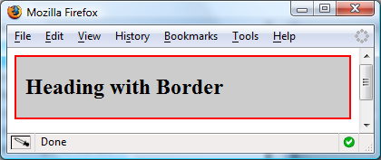
Two-value padding shorthand
Two numeric values
first value configures top and bottom padding
the second value configures left and right padding
h2 { border: 2px solid #ff0000;
background-color: #cccccc;
padding: 20px 10px;
}

Slide 18
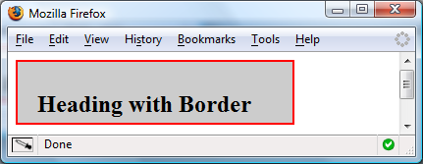
Four-value padding shorthand
Four numeric values
top, right, bottom, and left padding
h2 {
padding: 30px 10px 5px 20px;
}

Slide 19

Horizontal Rule Element
<hr> - configures a horizontal line

Slide 20

Checkpoint 4.1
1. Is it reasonable to try to code a web page that looks exactly the same on every browser and every platform? Explain your answer.
2. When a web page containing the style rules below is rendered in a browser, the border does not display. Describe what is incorrect with the following code:
h2 { background-color: #ff0000
border-top: thin solid #000000
}
3. True or False? CSS can be used to configure visual elements such as rectangular shapes and lines on web pages.

Slide 21

Web Graphics
Informative
Decorative
Commonly used types
GIF
JPG
PNG
Any other type you know?

Slide 22
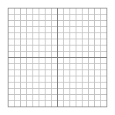
GIF
Maximum of 256 colors
One color can be configured as transparent
Can be animated
Uses lossless compression
Can be interlaced
Best used for line art and logos

Slide 23

JPEG
Joint Photographic Experts Group
Up to 16.7 million colors
Use lossy compression
Cannot be animated
Cannot be made transparent
Can be interlaced

Slide 24
PNG
Portable Network Graphic
Support millions of colors
Support multiple levels of transparency
Support interlacing
Use lossless compression
Browser support is growing

Slide 25

Foreground <img> Element
src = “url of the graphic”
alt = “alternate text description for accessibility”
height = “height (px) of the graphic”
width = “width (px) of the graphic”
display: inline
<img src=“dog.jpg” alt=“Dog at computer” height=“100” width=“100”>
25

Slide 26
Accessibility & Images
alt attribute required:
Describe the meaning of the image
NOT the name of the image
Use alt="" for purely decorative images
Recommendation for image links:
provide text links at the bottom of the page for image links

Slide 27
Image Link
Home
Use <a> element to contain an image element
Eliminate the border with CSS
img { border-style: none; }
<a href="index.html">
<img src="home.gif" height="19" width="85" alt="Home">
</a>

Slide 28
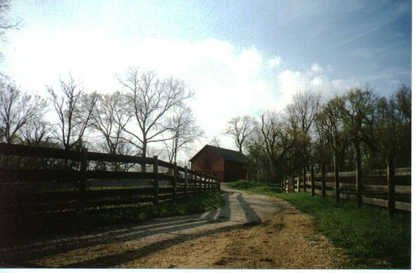

Thumbnail Image
A small image configured to link to a larger version of that image
<a href=“big.jpg”>
<img src=“small.jpg” alt=“country road” width=“200” height=“100”>
</a>

Slide 29
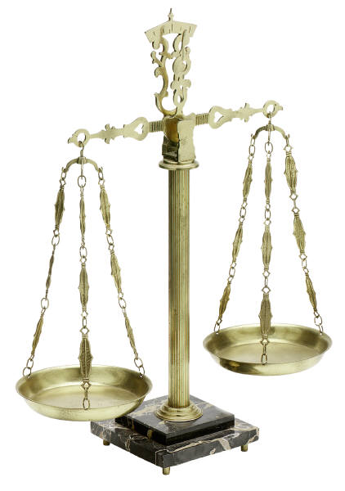
Image Optimization
Seeks a trade off between image quality and file size.
Photographs by digital cameras are not usually
optimized for the Web

Slide 30

Naming convention
Always lowercase letters
No punctuation symbols and spaces
short but descriptive
i1.gif is probably too short
myimagewithmydogonmybirthday.gif is too long
dogbday.gif may be just about right

Slide 31
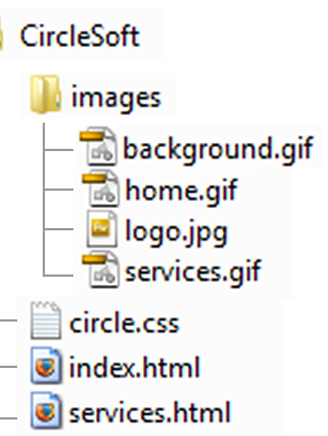
Organizing Your Site
Place images in their own folder
Code the relative file path
<img src=“images/home.gif” alt=“Home” height=“100” width=“200”>

Slide 32
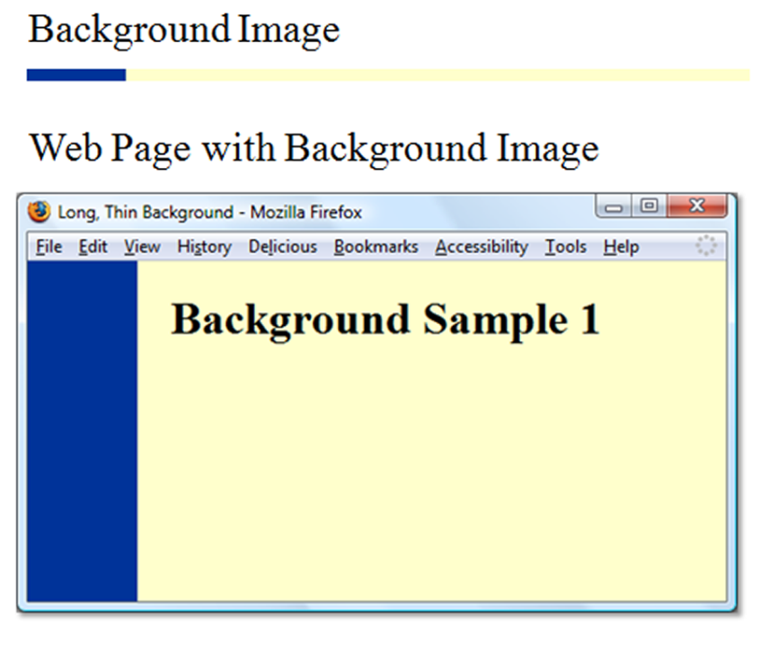
background-image Property
More for decorative purpose
No alt required
body { background-image: url(background1.gif); }

Slide 33
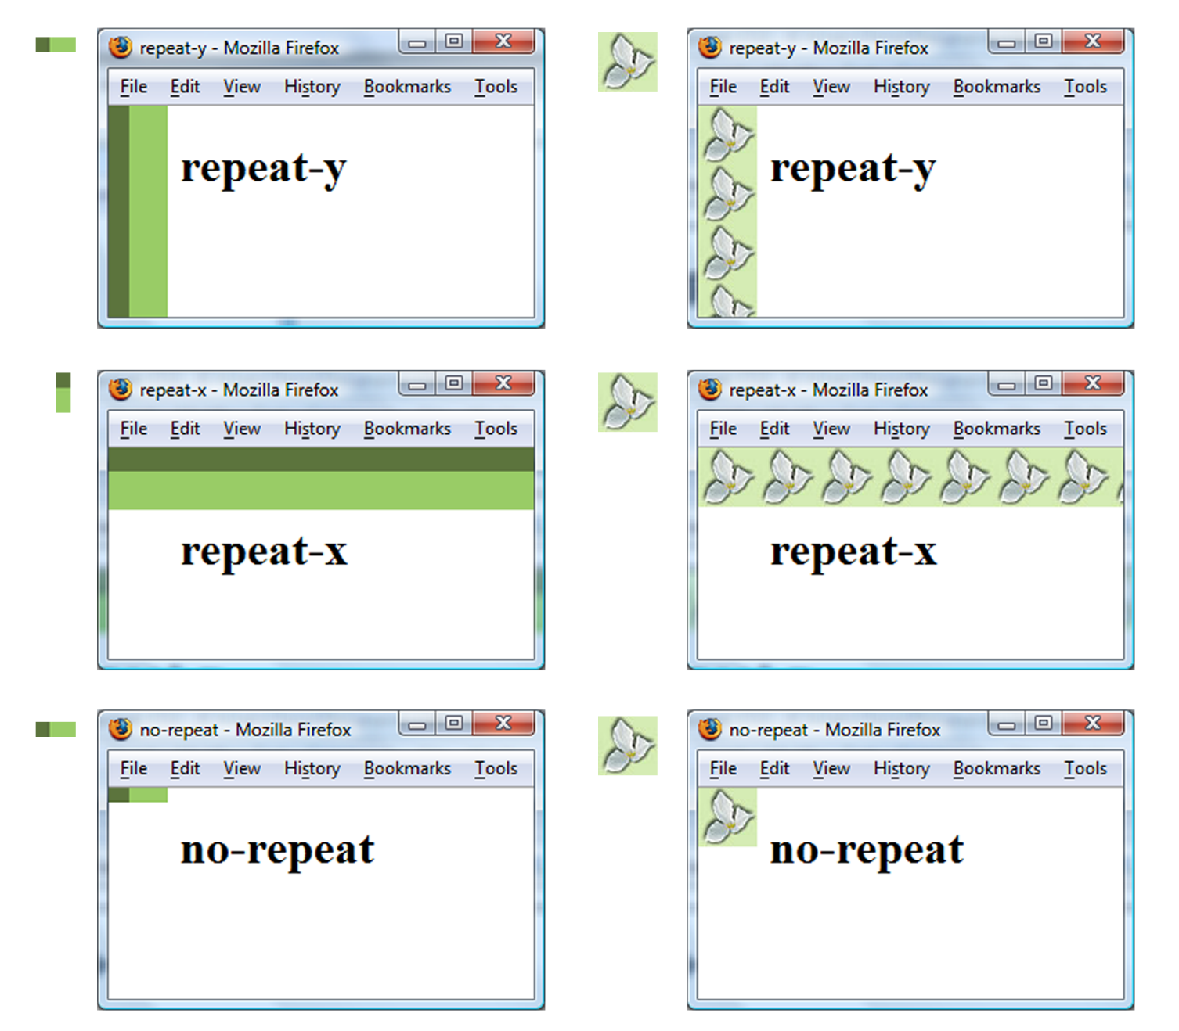
background-repeat Property

Slide 34

Using background-repeat
h2 { background-color: #d5edb3;
color: #5c743d;
padding-left: 30px;
background-image: url(trilliumbullet.gif);
background-repeat: no-repeat;
}

Slide 35
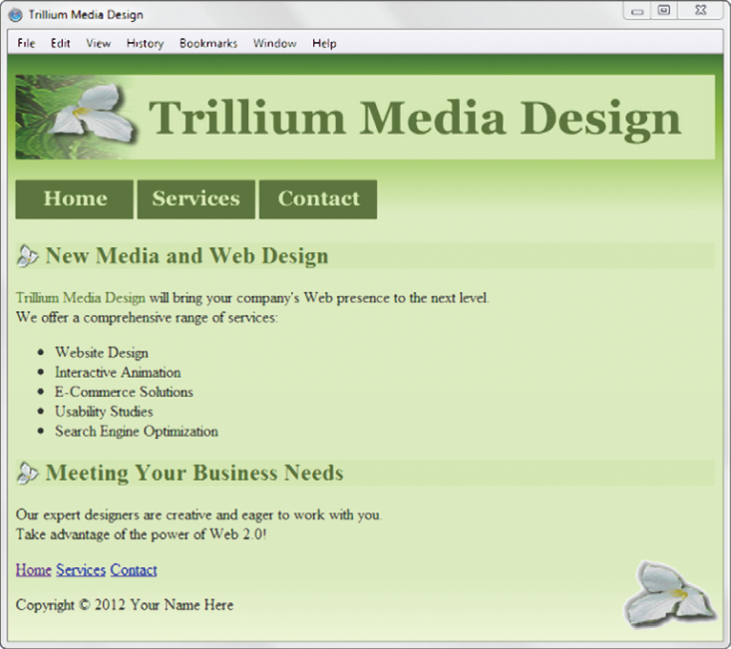
Multiple Background Images
body { background-color: #f4ffe4;
background: url(trilliumfoot.gif) no-repeat bottom right,
url(trilliumgradient.png);
}

Slide 36
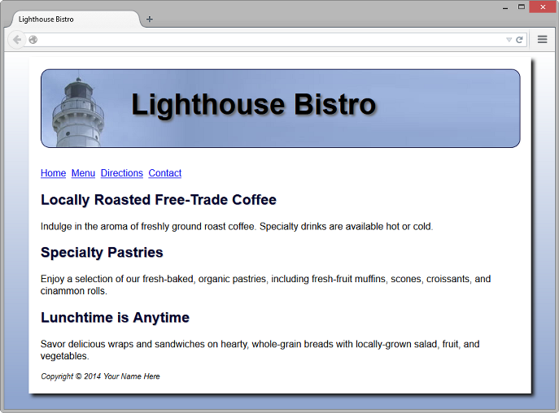
Background gradient
A smooth blending of shades from one color to another
Use background-image property:
linear-gradient() or radial-gradient()
body { background-color: #8FA5CE;
background-image: linear-gradient(#FFFFFF, #8FA5CE);
}

Slide 37
Maintain aspect ratio of images
img{ display:inline-block
width:100%;
height:auto;}

Slide 38
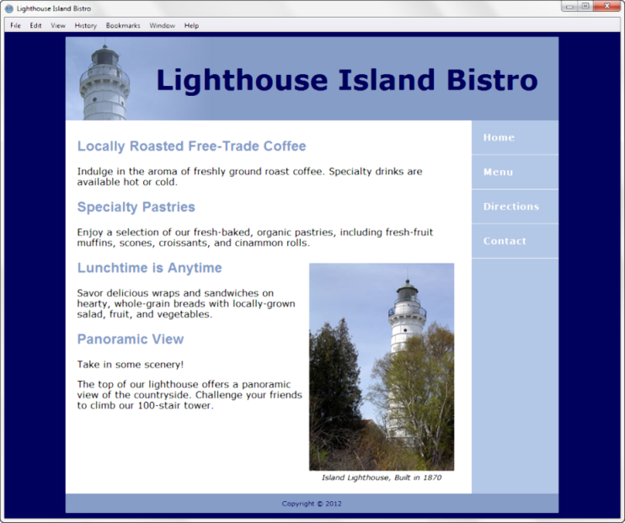
<figure> & <figcaption> Elements
<figure> - a self-contained image unit along with a <figcaption> description.
<figure>
<img src="lighthouseisland.jpg" width="250" height="355" alt="Lighthouse Island“>
<figcaption> Island Lighthouse, Built in 1870 </figcaption>
</figure>

Slide 39
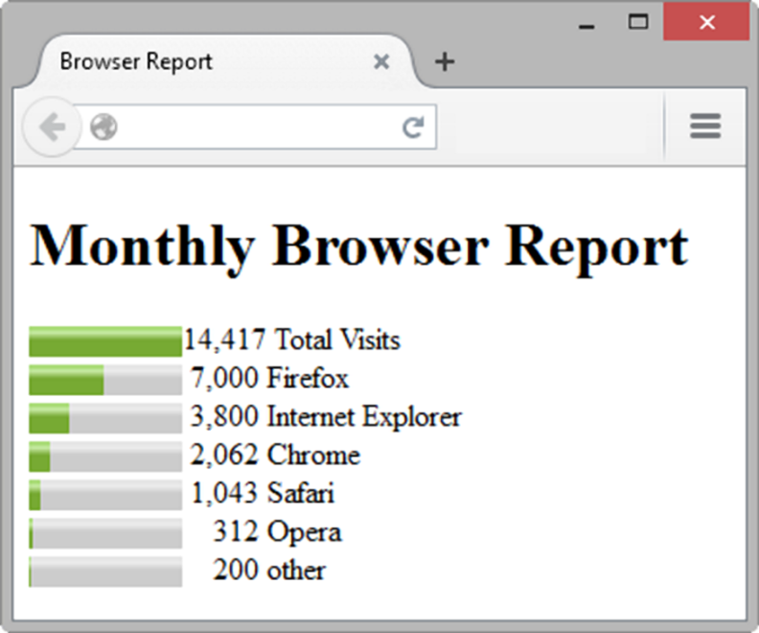
HTML5 <meter> Element
Displays a numeric-valued visual gauge
<meter value="14417" min="0" max="14417">14417</meter>14,417 Total Visits<br>
<meter value="7000" min="0" max="14417">7000</meter> 7,000 Firefox<br>
<meter value="3800" min="0" max="14417">3800</meter> 3,800 Internet Explorer<br>
<meter value="2062" min="0" max="14417">2062</meter> 2,062 Chrome<br>
<meter value="1043" min="0" max="14417">1043</meter> 1,043 Safari<br>
<meter value="312" min="0" max="14417">312</meter> &nbsp;&nbsp; 312 Opera<br>
<meter value="200" min="0" max="14417">200</meter> &nbsp;&nbsp; 200 other<br>

Slide 40
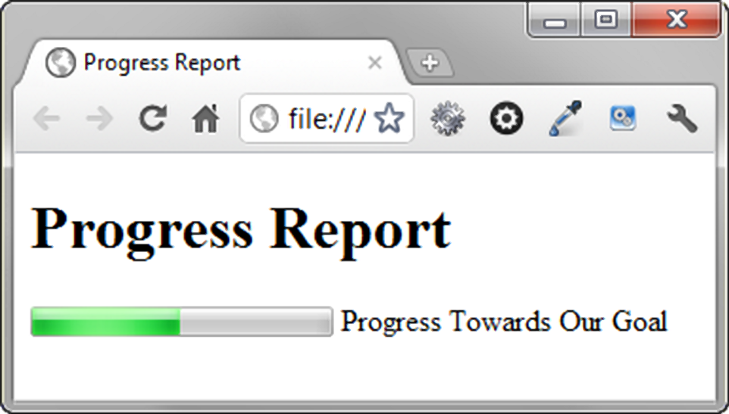
HTML5 <progress> Element
A bar that depicts a numeric value within a specified range
<progress value="5000" max="10000">5000</progress> Progress Towards Our Goal

Slide 41
Checkpoint 4.2
1. Describe the CSS to configure a graphic named circle.jpg to display once in the background of all <h1> elements. Code sample CSS to demonstrate this.
2. Describe the CSS that configures a file named bg.gif to repeat vertically down the background of a web page. Code sample CSS to demonstrate this.
3. Explain how the browser will render the web page if you use CSS to configure both a background image and a background color.

Slide 42
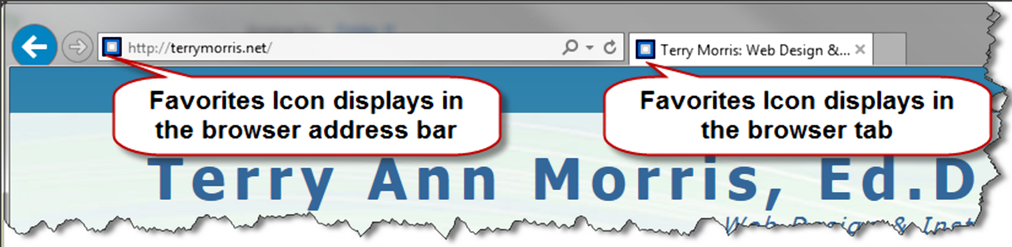


Favorites Icon
A square image associated with a web page
Usually named “favicon.ico”
May display in the browser address bar, tab or bookmark
Configure with a link tag:
<link rel="icon" href="favicon.ico" type="image/x-icon">

Slide 43

CSS Sprites
An image file that contains multiple small graphics
To optimize the use of multiple icon or small images
To save overhead by reducing the number of http requests
Source: https://www.pngitem.com/download/TbRwT_social-media-marketing-icon-transparent-background-social-media/

Slide 44
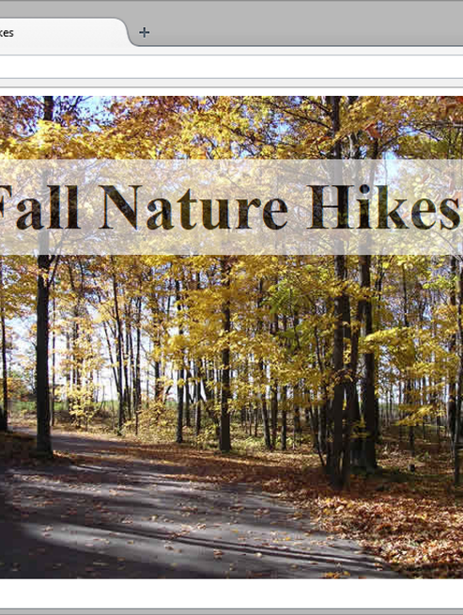
opacity Property
Control the opacity of an entire element
opacity range : [0, 1]
0 - completely opaque
1 - completely transparent
h1{ background-color: #FFFFFF;
opacity: 0.6;
}

Slide 45
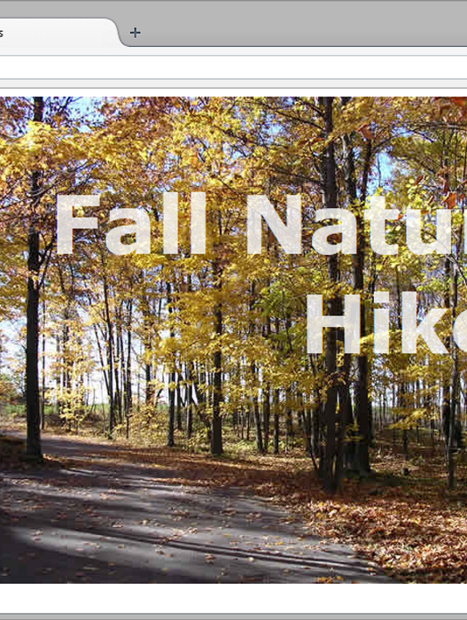
rgba() Color
red, green, blue & alpha (transparency) components
alpha value range: [0, 1]
(0=full transparent, 1=fully opaque)
h1 { color: rgba(255, 255, 255, 0.7);}
Shall I use opacity or rgba()?

Slide 46

Summary
This chapter introduced the use of visual elements and graphics on web pages.
As you continue to create web pages, look back at the guidelines and accessibility issues related to graphics.
The number one reason for visitors to leave web pages is too long of a download time. When using images, be careful to minimize this issue.
Provide alternatives to images (such as text links) and use the alt attribute on your pages.

